Slide 1

Supply Chain Analysis
(Clustered Confusion Team)

Slide 2

This project was designed to analyze and visualize data to extract useful information that is essential for decision-making in the business world (Supply Chain), By honing our skills in cleaning, processing, and analyzing data combined with elegant visuals, we created a comprehensive report that is both simple and effective.
Project
After analysis, this Data demonstrated that there is room for improvement in these departments :
1. Product Spotlight
2. Discount Policies
3. Shipping Service
4. Geographic Availability
5. Customer Reward Programs

Slide 3
Data Structure
Data was Collected From Kaggle (Stored as CSV)
Accessed: Loaded using Python
Data is balanced in Late Delivery Risk: Late/Not Late: 98977/81542
Data cleaned by removing nulls, fixing types, removing useless columns etc.
Data Architecture: Non-Relational Source: CSV file Shape: 180,519 rows × 35 columns
Main entity: Orders
Related Entities: Customer info, Product info, & Category info
Programming languages and libraries: Python, NumPy, seaborn and matplotlib

Slide 4
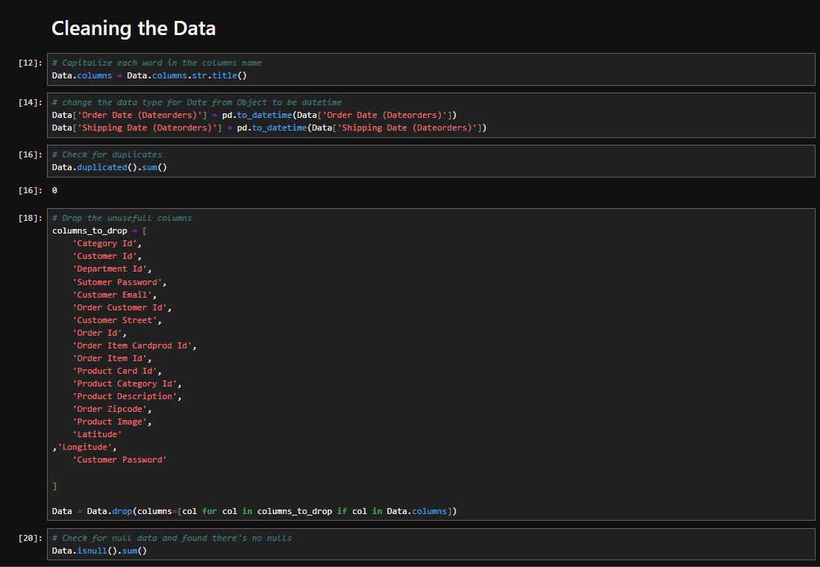
Data Cleaning
Converted data types for date columns to ensure proper time-based analysis.
Dropped unnecessary columns to streamline the dataset.
Corrected wrong values in the Customer State column with accurate state names.
Filled nulls in the Last Name column and created a new Full Name column by combining first and last names.
Translated country names from Spanish to English for consistency.

Slide 5
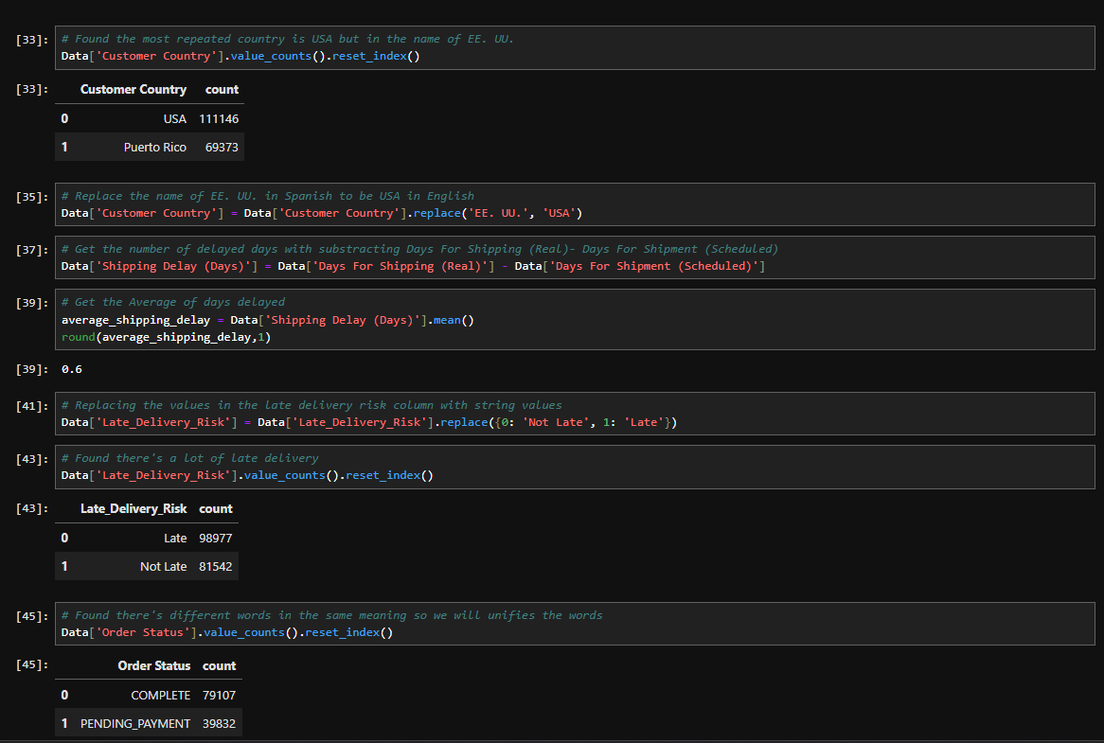
Data Cleaning (Cont’d)
Created a new column Shipping Delay (Days) by calculating the difference between expected and actual shipping dates.
Replaced numerical values in Late Delivery Risk and Product Status with descriptive labels.
Standardized similar values in Order Status for accurate grouping.
Created a Season column based on order dates to analyze seasonal trends.

Slide 6
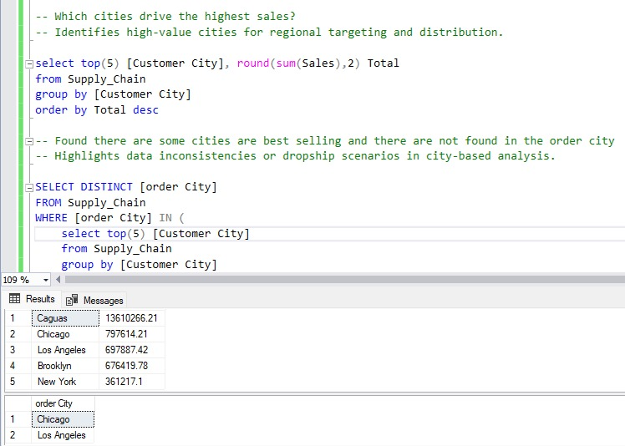
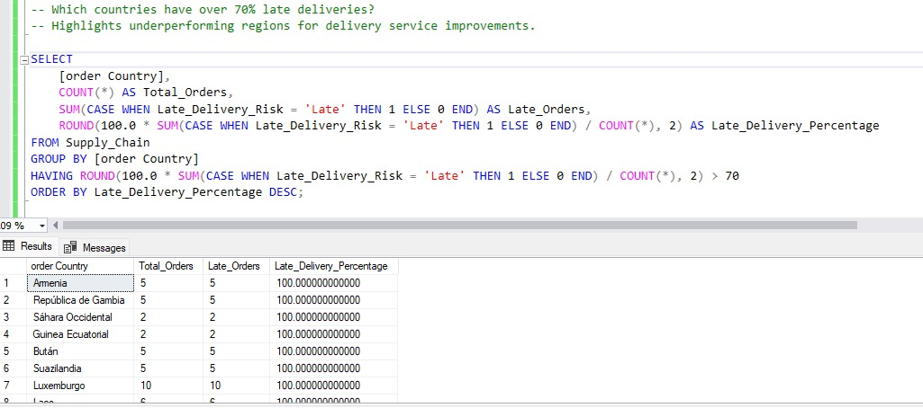
SQL Analysis
Caguas has the highest number of orders. However, It does not have a store causing delays.
Several cities have a late delivery rate over 70%.

Slide 7
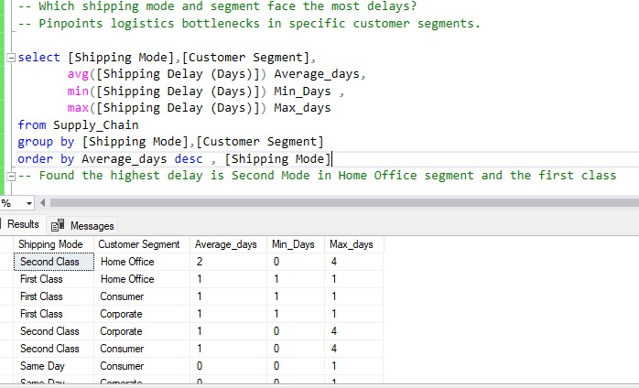
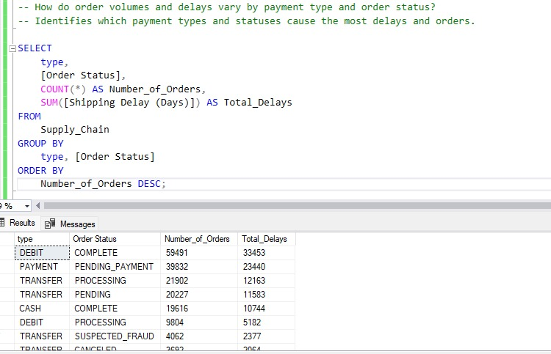
SQL Analysis (Cont’d)
First and Second-class shipping modes have the highest average delays.
While Debit is the most used payment method orders with transfer payment methods often fail.

Slide 8
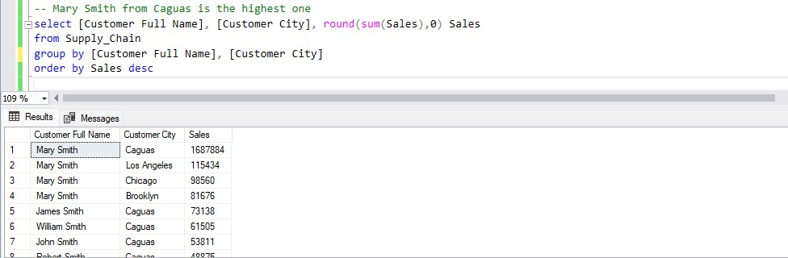
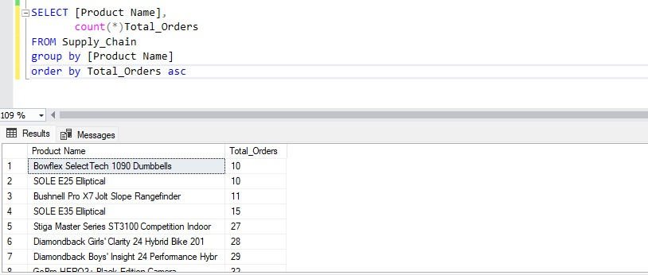
SQL Analysis (Cont’d)
We identified loyal customers that contributed to a majority of sales especially multiple Mary Smiths from various locations.
We Found Multiple Low performing Products.

Slide 9
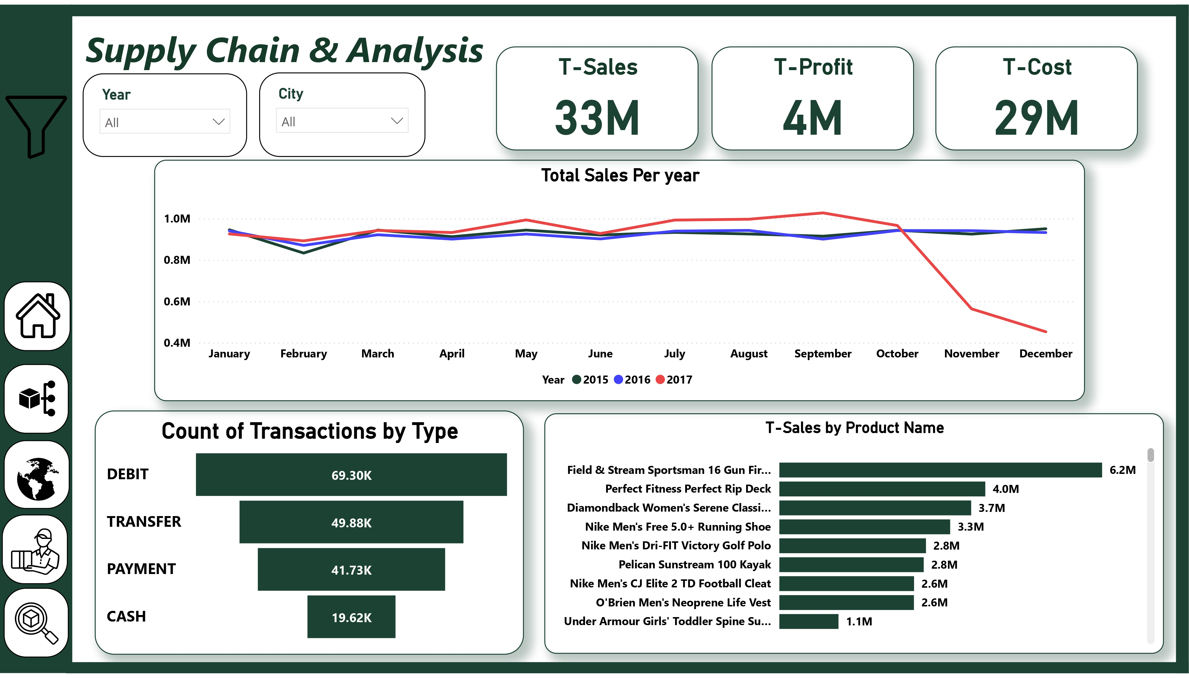
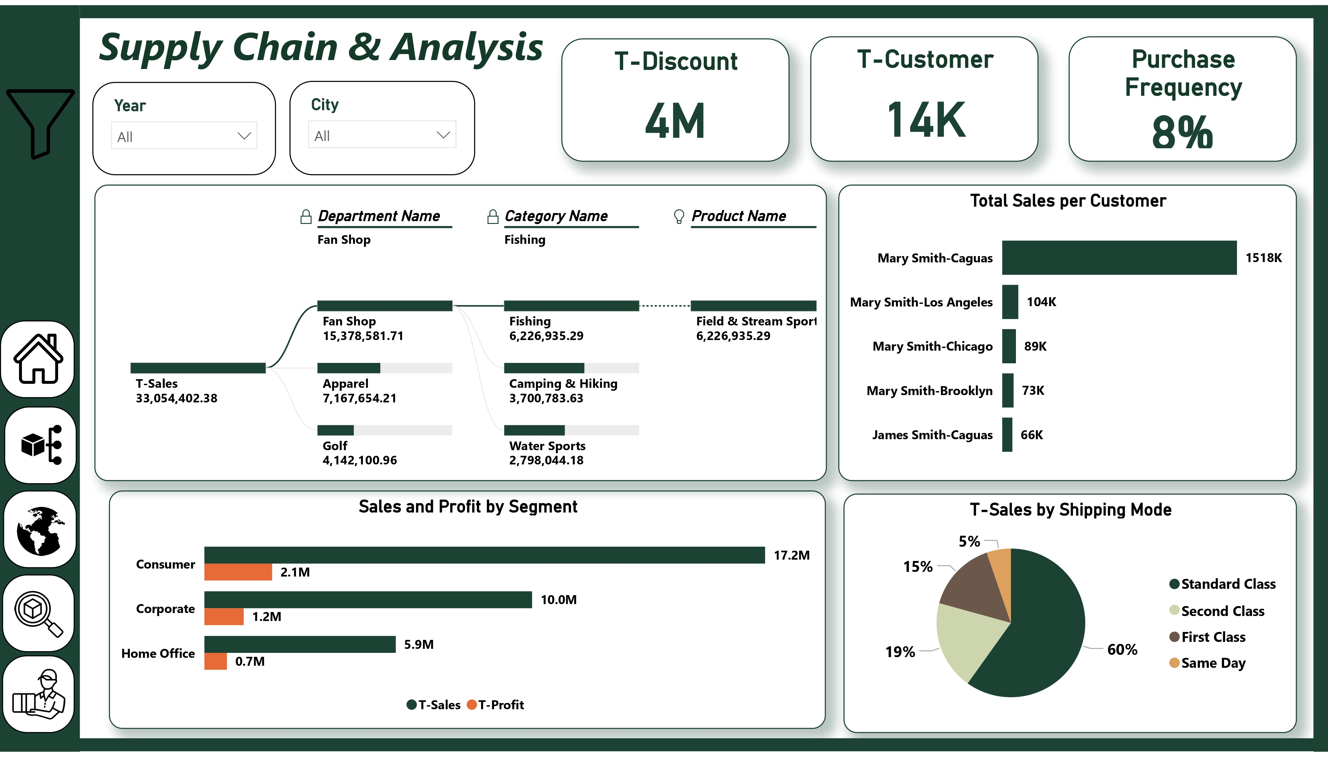
Power PI Dashboard

Slide 10
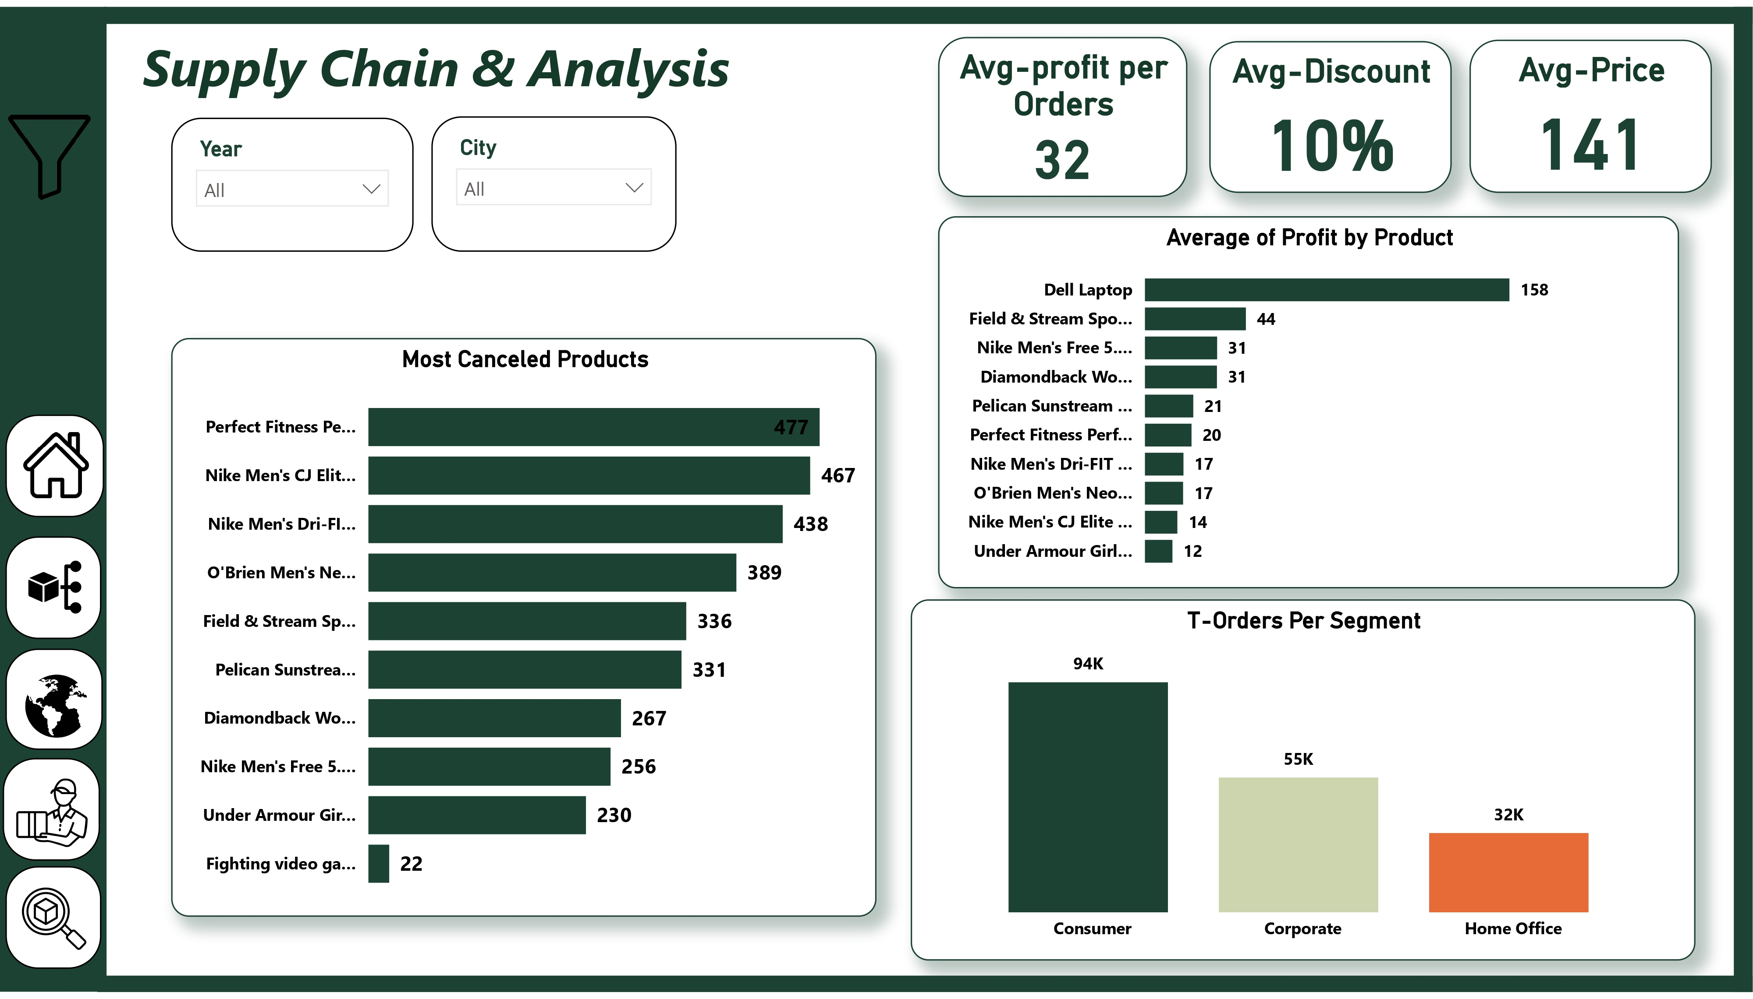
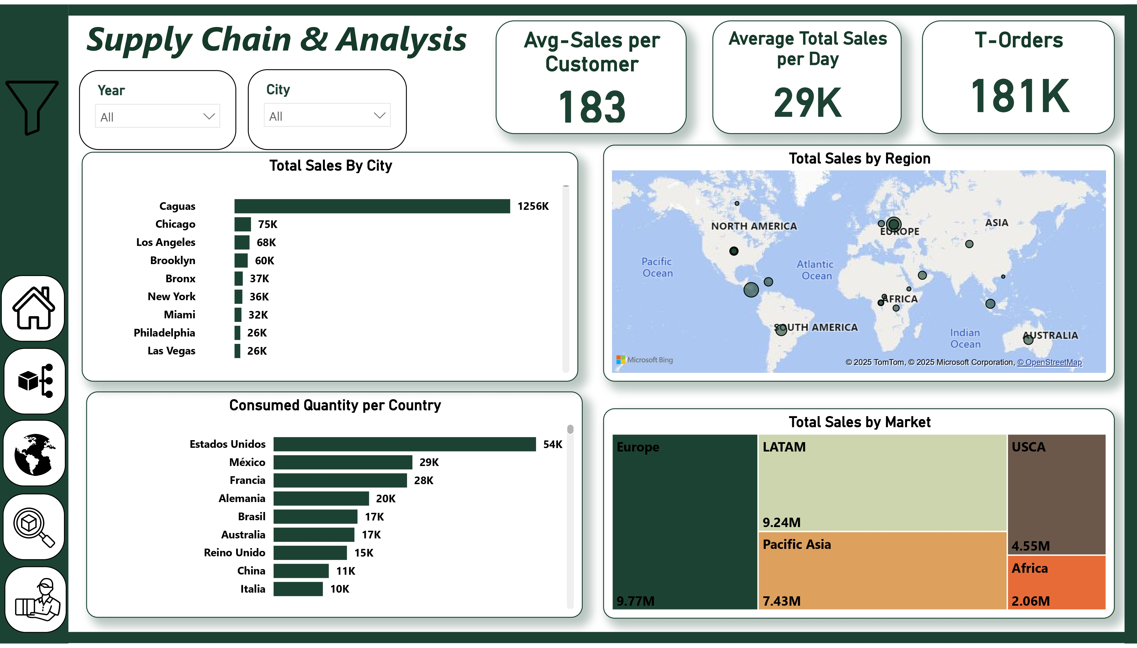
Power PI Dashboard (Cont’d)

Slide 11
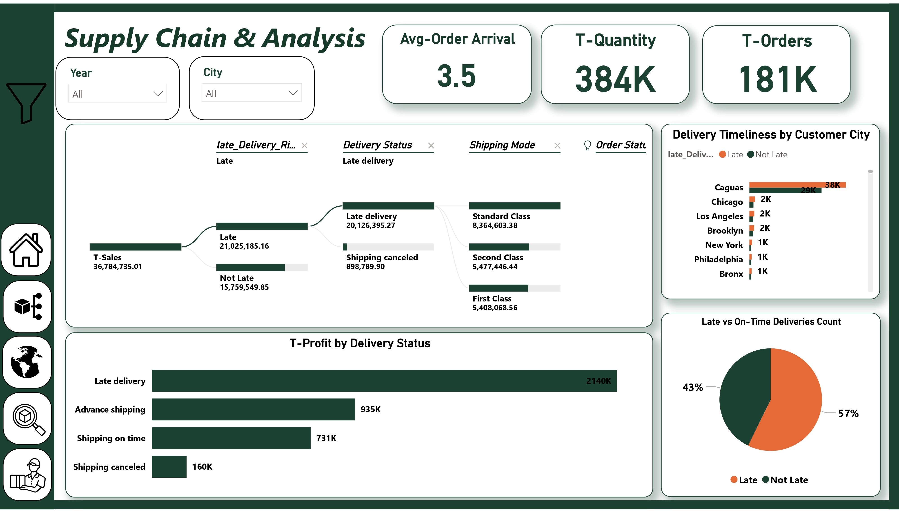
Power PI Dashboard (Cont’d)
Power PI revealed to us that there is consistent and minimal deviation of performance for the given timeline of the data, and a clear lack of geographic reach which is apparent when looking at Caguas Total Sales.
Moreover, over half of all deliveries arrive late and more than 50% of orders never end up being completed.

Slide 12
Recommendations
Open multiple stores in Caguas and adjacent cities.
Improve customer service and use feedback forms to better understand the low customer retention rate.
Optimize these shipping modes and enhance customer support for affected segments.
Use trusted payment gateways to ensure secure payment processing.
Create tailored offers and loyalty programs to retain top customers.
Offer discounts and combo deals to increase customer interest and sales or stop production entirely.

Slide 13
Much Thanks For Your Time
Any questions?

Slide 14
Team Members & Roles
Osama Tarek : Team Leader & Report
Yara Khaled : Data Cleaning & Analysis
Mohamed Hatem : Power PI Dashboard
Hanin El Sherif : Domain Understanding
Mina Maher : Story & PPT.

